Slide 1
Patlak reference tissue model
Logan plot
Oct 20, 2023
Zeyu Zhou
MIRA Group Meeting Review

Slide 2




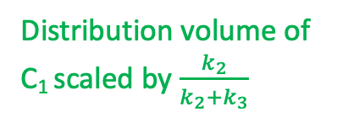


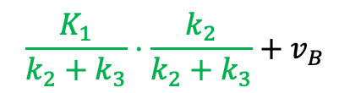

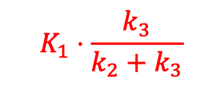

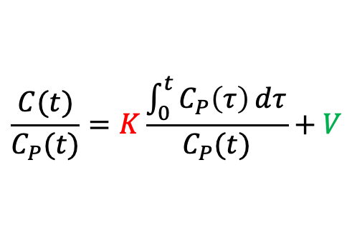
Review: Patlak plot
Assumption: irreversible uptake/binding
$$C=C_{1}+C_{2}$$
$$\frac{C(t)}{C_{P}(t)}=K\frac{\int_{0}^{t}{C_{P}\left(τ\right)ⅆτ}}{C_{P}(t)}+V$$
for $t>t^{∗}$
$$K_{1}$$
$$k_{3}$$
$$C_{P}$$
$$C_{1}$$
$$C_{2}$$
$$K_{1}⋅\frac{k_{3}}{k_{2}+k_{3}}$$
$$\frac{K_{1}}{k_{2}+k_{3}}⋅\frac{k_{2}}{k_{2}+k_{3}}+v_{B}$$
$$k_{2}$$
Overall uptake rate from plasma to C₂
Distribution volume of C₁ scaled by $\frac{k_{2}}{k_{2}+k_{3}}$

Slide 3
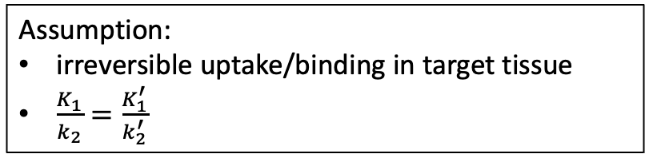





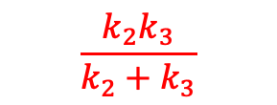
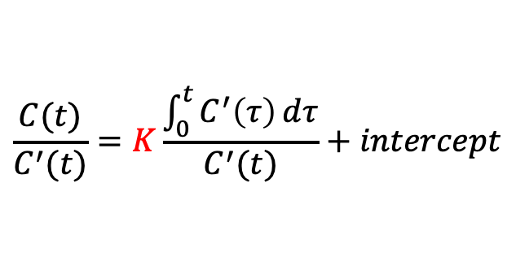

Patlak reference tissue model
Assumption:
irreversible uptake/binding in target tissue
$\frac{K_{1}}{k_{2}}=\frac{K_{1}^{′}}{k_{2}^{′}}$
$$C=C_{1}+C_{2}$$
$$K_{1}$$
$$k_{3}$$
$$C_{2}$$
$$\frac{C(t)}{C^{′}(t)}=K\frac{\int_{0}^{t}{C^{′}\left(τ\right)ⅆτ}}{C^{′}(t)}+intercept$$
for $t>t^{∗}$
$$k_{2}$$
$$C_{P}$$
$$\frac{{k_{2}k}_{3}}{k_{2}+k_{3}}$$
Interpretation?
$$K_{1}^{′}$$
$$C_{1}^{′}$$
$$k_{2}^{′}$$
$$C=C_{1}$$

Slide 4
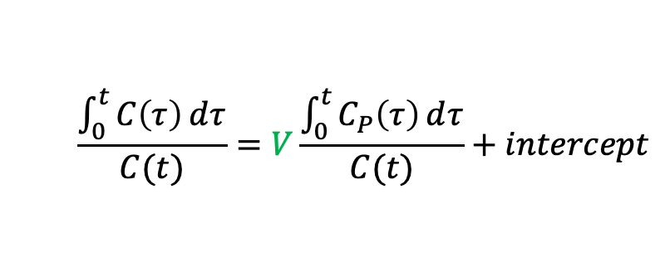

Logan plot
Assumption: reversible uptake/binding
$$\frac{\int_{0}^{t}{C\left(τ\right)ⅆτ}}{C(t)}=V\frac{\int_{0}^{t}{C_{P}\left(τ\right)ⅆτ}}{C(t)}+intercept$$
for $t>t^{∗}$

Slide 5







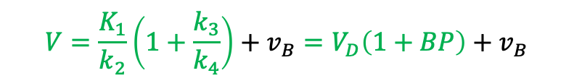

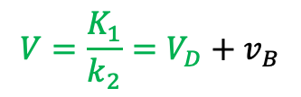


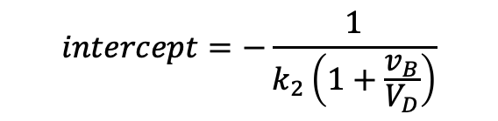



Logan plot
Assumption: reversible uptake/binding
$$\frac{\int_{0}^{t}{C\left(τ\right)ⅆτ}}{C(t)}=V\frac{\int_{0}^{t}{C_{P}\left(τ\right)ⅆτ}}{C(t)}+intercept$$
for $t>t^{∗}$
$$C=C_{1}$$
$$K_{1}$$
$$V=\frac{K_{1}}{k_{2}}=V_{D}+v_{B}$$
$$intercept=−\frac{1}{k_{2}\left(1+\frac{v_{B}}{V_{D}}\right)}$$
$$C_{P}$$
$$C_{1}$$
$$k_{2}$$
Distribution volume
$$C=C_{1}+C_{2}$$
$$K_{1}$$
$$k_{3}$$
$$V=\frac{K_{1}}{k_{2}}\left(1+\frac{k_{3}}{k_{4}}\right)+v_{B}=V_{D}\left(1+BP\right)+v_{B}$$
$$C_{P}$$
$$C_{1}$$
$$C_{2}$$
$$k_{2}$$
$$k_{4}$$
$V_{D}:$Distribution volume of C₁

Slide 6










Patlak plot vs. Logan plot
$$C=C_{1}+C_{2}$$
Assumption: irreversible uptake/binding
$$K_{1}$$
$$k_{3}$$
$$\frac{C(t)}{C_{P}(t)}=K\frac{\int_{0}^{t}{C_{P}\left(τ\right)ⅆτ}}{C_{P}(t)}+V$$
$$C_{P}$$
$$C_{1}$$
$$C_{2}$$
for $t>t^{∗}$
$$k_{2}$$
$$C=C_{1}+C_{2}$$
Assumption: reversible uptake/binding
$$K_{1}$$
$$k_{3}$$
$$\frac{\int_{0}^{t}{C\left(τ\right)ⅆτ}}{C(t)}=V\frac{\int_{0}^{t}{C_{P}\left(τ\right)ⅆτ}}{C(t)}+intercept$$
$$C_{P}$$
$$C_{1}$$
$$C_{2}$$
for $t>t^{∗}$
$$k_{2}$$
$$k_{4}$$

